Slide 1
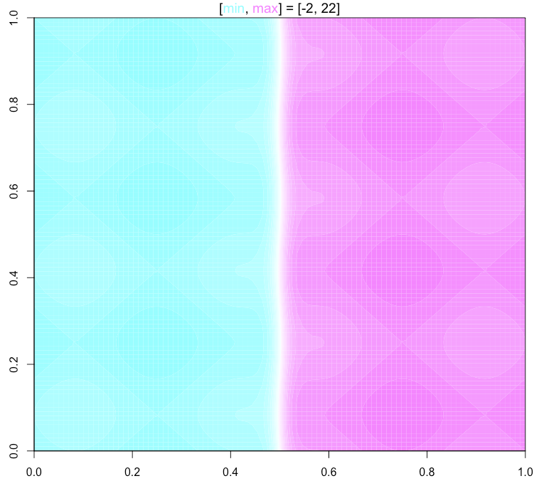
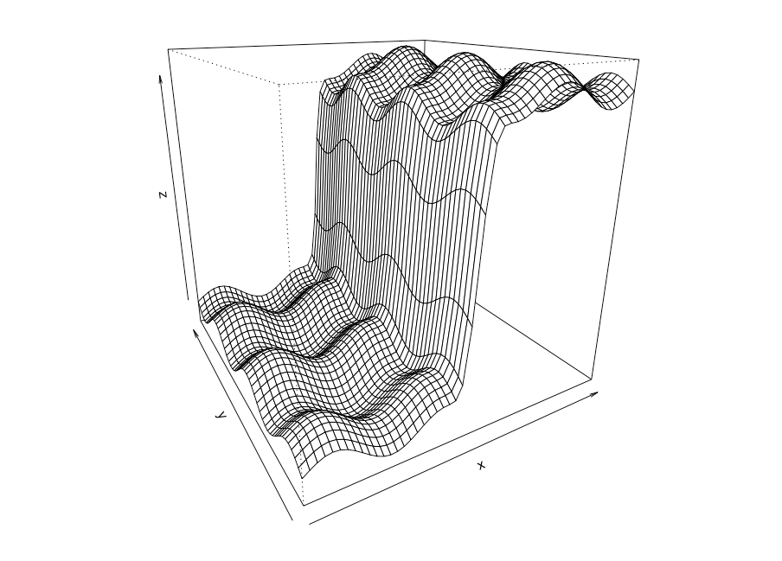
Adaptive design for simulations
Collin Erickson
SEED Center
8/25/16

Slide 2
Adaptive designs for simulations
Want to understand variable interaction
Simulations can be very expensive
Goal: understand response and identify interesting areas
Need to spread points across surface
Need to focus points in regions
How can we balance these?

Slide 3
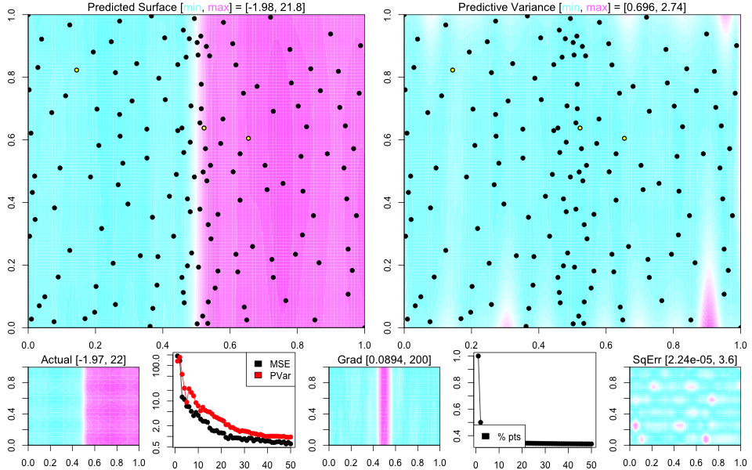
Gradient and minimum energy
Use gradient to determine interesting areas
Use minimum energy to keep points spread out
Can be run indefinitely
Coded in R
Use on Navy simulations

Slide 4
Gif of result

